Slide 1
Multi Alphabet/Image/Number Sequence Learning by Damir Dobric
Gaurav Honnavara Manjunath - 1384178
Harish Palanivel - 1392283
Prajwal Praveen Athkar - 1394663

Slide 2
Objective/Abstract
The evolution of life on Earth has developed the human brain containing the cortex which in the environment processes a series of sensory information and builds temporary memory. This leads to identifying and foretelling information about the previously visualized functions like speech recognition, natural vision, and sequences of information. In real-life situations, the prediction and perception of temporal sequences for sensory inputs are useful/critical. Based on multiple known features of neurons, a theoretical framework has been proposed for sequence learning in the cortex is known as Hierarchical Temporal Memory (HTM) sequence learning. The model using temporal memory can handle varying the sequences by keeping the predictions until valid evidence is available. HTM’s ability to predict future patterns arrive from learning which patterns are likely to follow each other. In scenarios when HTM receives a unique pattern, it compares historically received patterns with the new pattern. As input never repeats in the same fashion, the uniqueness of sequence is critical for recognizing inputs. HTM uses shifting order memory, which enables it to predict using variable-length sequences

Slide 3
Introduction
Medical Science and ML engineers were working on the understanding of cortex for temporal pattern recognition.
HTM (Hierarchical Temporal Memory) has been proposed for sequence learning.
HTM is a biomimetics model based on the principle of memory predictions.

Slide 4
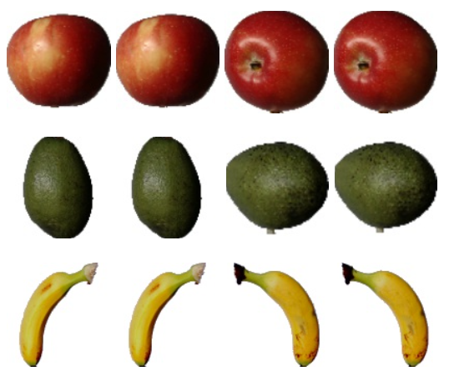
Methodology
Labels | Sequence
Multiples of 2 | {2,4,6,8,10,12,14,16}
Multiples of 3 | {3,6,9,12,15,18,21,24}
Multiples of 5 | {5,10,15,20,25,30,35,40}
Multiples of 7 | {7,14,21,28,35,42,49}
Multiples of 11 | {11,22,33,44}
Multi Sequence Learning – Numbers
Multi Sequence Learning – Image Datasets
Sequence | Labels
AIGKFLHSAKKFGKAFVGEIMNS | mod. active
FAKIIAKIAKIAKKIL | inactive - exp
FAKKLAKKLKKLAKKLAKKWKL | mod. active
FAKLLAKALKKLL | very active
…. | ….
Multi Sequence Learning - Alphabets

Slide 5
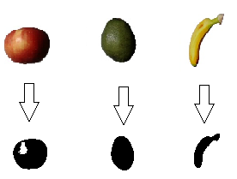
Encode
Numbers and Alphabets use Scalar encoder
Image use HTM Image encoder
Image Binarization

Slide 6
Spatial Pooler
Spatial Pooler
Temporal Memory
Classifier
Creates SDR Input
Columns that are not active is not learnt
Each pattern that is appeared as input is compared with the database

Slide 7
Learning Phase
For Numbers and Alphabets
Fetches datasets and train using Spatial Pooler
Homeostatic Plasticity Controller is used for Stability
Spatial Pooler trains each sequence for several iterations to attain stability
For Image
The datasets are fetched as .jpg file and is binarized using Encoder
Spatial Pooler is used to train the binarized datasets for several iterations

Slide 8
Project Flow
Start
Enter an option to run a multisequence experiment
Multisequence Learning - Numbers
Check User Input
Multisequence Learning - Alphabets
Train Datasets
Testing
Multisequence Learning - Image
User Entered Invalid Number
End Program

Slide 9
Results
Cycles and accuracy we can add

Slide 10
Conclusion

Slide 11
References
Keele, "“Sequence learning,” - B. A. C. G. J. D. S. W.," 1998. [Online]. Available: https://pubmed.ncbi.nlm.nih.gov/21227209
"D. V. B. Michael D Mauk, “Sequence learning,”," 2004. [Online]. Available: https://pubmed.ncbi.nlm.nih.gov/15217335
"B. H. J. L. R. .Rabiner, “An introduction to hidden markov models,”," 1986. [Online]. Available: http://ai.stanford.edu/~pabbeel/depth_qual/Rabiner_Juang_hmms.pdf.
Hawkins, "J. C. S. A. J. , “Continuous online sequence learning with an unsupervised neural network model,”," 2016. [Online]. Available: https://pubmed.ncbi.nlm.nih.gov/27626963
S. A. J. Hawkins, "“Why neurons have thousands of synapses, a theory of sequence memory in neocortex,”," 2016. [Online]. Available: https://www.frontiersin.org/articles/10.3389/fncir.2016.00023/full.

